Slide 1

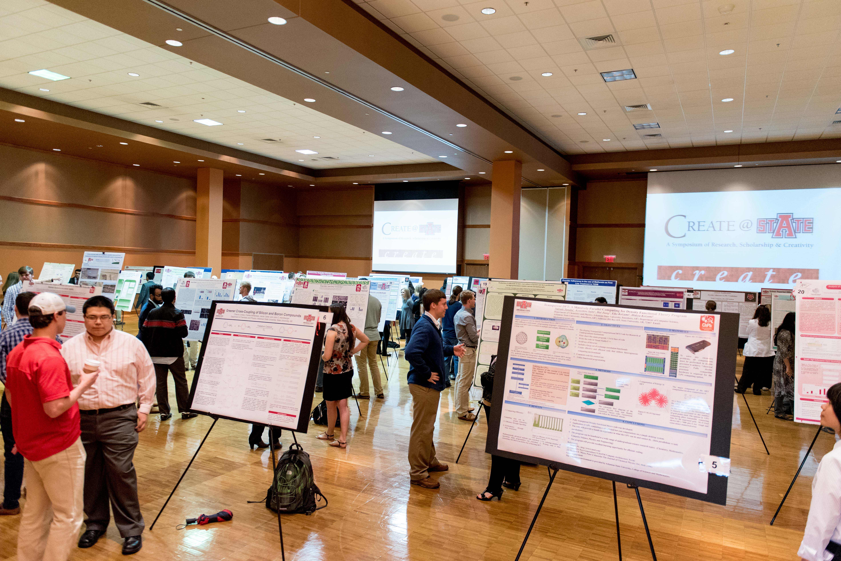


Pilot of a Co-Curricular Assessment Model at
Arkansas State University for Student Research Events
Emily Devereux, MPA, CRA
Executive Director, Research & Tech Transfer
Advisor, A-State Student Research Council
AState.edu
/AStateResearch
@AStateResearch
Learn @ State, March 13, 2019, Arkansas State University
A-State Student
Research Council

Slide 2

Application of Assessment
Co-curricular student learning assessment added summer of 2017 to determine:
1. Students learning from abstract submission process
2. Student confidence levels were increasing from:
      Creative and critical thinking
      Communication skill attainment
Study has contributed to design of CUR National Student Research Events Assessment Tool Pilot.
AState.edu
/AStateResearch
@ArkansasState
Learn @ State, March 14, 2018, Arkansas State University
A Celebration of Investigations into Student-Learning Assessment
A-State Student
Research Council

Slide 3
Original Purpose:
High-impact learning
Leverage of Success:
Faculty utilize to assess student learning for culminating-program level projects
Co-Curricular leaders assess SLO’s from the symposium experience, including student ambassadors serving as peer mentors
External engagement
AState.edu
/AStateResearch
@ArkansasState
Learn @ State, March 14, 2018, Arkansas State University
A Celebration of Investigations into Student-Learning Assessment
A-State Student
Research Council

Slide 4
Inclusion of External Engagement
Engagement of industry, community leaders and alumni to provide feedback about student learning and career opportunities
46% increase from 48 judges in 2017 to 70 judges in 2018
Engagement in the classroom and in student professional groups
Investment in endowments and gifts for student research and creativity; industrial labs and faculty research contracts
AState.edu
/AStateResearch
@ArkansasState
Learn @ State, March 14, 2018, Arkansas State University
A Celebration of Investigations into Student-Learning Assessment
A-State Student
Research Council

Slide 5
Standard Pathway
Create @ State used to substantiate
A-State’s argument for reaffirmation in core components.
1D, 2D, 3B, 3D, and 4B
AState.edu
/AStateResearch
@ArkansasState
Learn @ State, March 14, 2018, Arkansas State University
A Celebration of Investigations into Student-Learning Assessment
A-State Student
Research Council

Slide 6
Program Implementation and Outcomes
137% student participation growth from 108 presenter in 2015 to 257 presenters in 2018
70% reported they had not had an opportunity to present in a conference setting
Abstract writing skills averaged 84% across the 5 colleges who applied abstracts
Presentation skills averaged 81% between the 6 colleges who presented
AState.edu
/AStateResearch
@ArkansasState
Learn @ State, March 14, 2018, Arkansas State University
A Celebration of Investigations into Student-Learning Assessment
A-State Student
Research Council

Slide 7
Action Plan Implementation 2018-2019
A-State’s student research and creativity development program, Create @ State, is a year-long program that provides our students with opportunities to become engaged in faculty mentored research and creativity with industry, community, and alumni for student learning and community building.
AState.edu
/AStateResearch
@ArkansasState
Learn @ State, March 14, 2018, Arkansas State University
A Celebration of Investigations into Student-Learning Assessment
A-State Student
Research Council

Slide 8
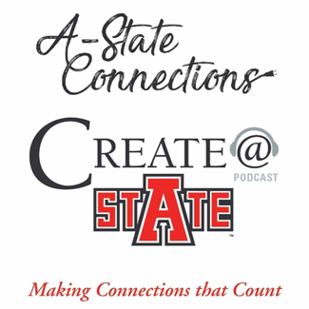
Action Plan Implementation 2018-2019
Implementation of Communication Opportunities:
A-State Connections: Making Connections that Count
(Weekly NPR affiliate radio broadcast & podcast station featuring faculty, students and community)
AState.edu
/AStateResearch
@ArkansasState
Learn @ State, March 14, 2018, Arkansas State University
A Celebration of Investigations into Student-Learning Assessment
A-State Student
Research Council

Slide 9
Action Plan Implementation 2018-2019
Implementation of Communication Opportunities:
Structured programming with A-State Learning Commons for peer mentoring: Writing Center and Communications Center
Year-long direct corporate engagement with area industry and workforce for applied research.
AState.edu
/AStateResearch
@ArkansasState
Learn @ State, March 14, 2018, Arkansas State University
A Celebration of Investigations into Student-Learning Assessment
A-State Student
Research Council

Slide 10
2019 Create @ State Symposium:
Increase in presenters and presentations across disciplines
More than 80 faculty members contributing to co-curricular assessment
AState.edu
/AStateResearch
@ArkansasState
Learn @ State, March 14, 2018, Arkansas State University
A Celebration of Investigations into Student-Learning Assessment
A-State Student
Research Council

